Slide 1
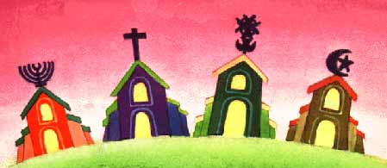

Homosexuality, transidentity:
Crossing perspectives on Monotheistic religious texts
.
Dr. & Imam Ludovic-Mohamed Zahed
Directeur de CALEM – Institut de formations, Cabinet conseils, Maison d’éditions

Slide 2
SUMMARY
Gender studies applied to the three monotheisms: an ethical revolution?
The Patriarchal Ethics of Semitic Judaism
What the Bible says, and does not say
The Quran and the tradition of the Prophet of Islam ASWS
Fascism: product of the social context, cultural facade and / or religiosity?
“Infrahumanization”: fascistic scapegoating of minroties, theoretically and practically
Example of LGBT interfaith associative network
2

Slide 3
1. GENDER STUDIES AND RELIGION
It all starts in the 1980s,
an ethical and political stalemate?
Judith Butler ("queer pope", diverse gender identities) describes "biopower" (control over identities and the bodies of citizens) as to be rethought again, to go beyond what she qualifies as a "Political impasse" (decriminalization of homosexuality in France: 1981, increased criminalization of homosexuality in MENA).
Identity shaping (fascism = imposing a monolithic identity bundle) is now represented as organized from centers of diffuse, non-localized influence within communities and various societal spaces - in this case religious, which concerns our present reflection, but also at school, at university, at the hospital (Michel Foucault - Les Anormaux, 1976).
3

Slide 4
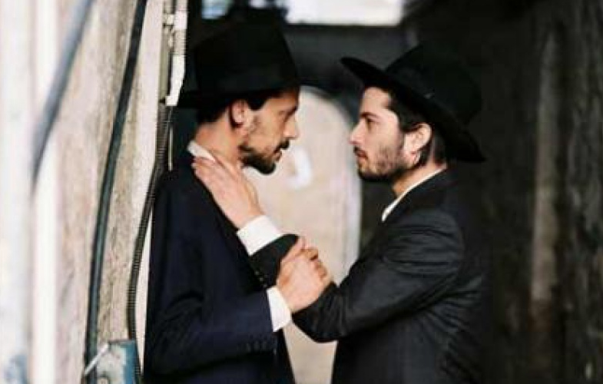
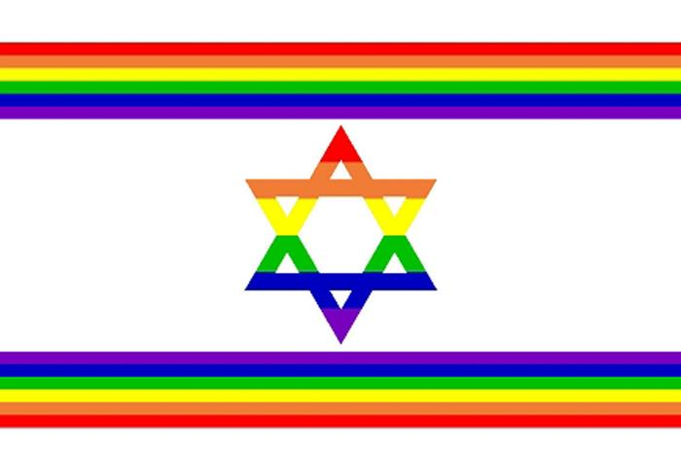
2. The Thorah
« Tu n’aimeras point », 2009.
4

Slide 5
2. The Patriarchal Ethics of Semitic Judaism
Halakha («going forward») & patriarcal traditions
"You shall say to the Israelites, Whoever among the Israelites or among the immigrants who are staying in Israel deliver to the Molek (God, Lord?) One of his children shall be put to death: the people of the land shall stone him“ (Leviticus: 20.2).
Already, a context of conflict between different civilizations...
"If a man sleeps with another man as one sleeps with a woman, they have both committed an abomination“ (Leviticus 20:13).
... moreover, we talk about religious practices (men of power). Practices that are "abominable" according to the views of Israelite ethics at that time.
* Divinité associée au dieu Baal
5

Slide 6
2. The Patriarchal Ethics of Semitic Judaism
Traditional interpretation of To’evah (« abomination »)
Different interpretations of this "abomination" emerge over the centuries and according to Talmudic commentators (in Jerusalem or Babylone) :
Prejudice: "The passive partner (recipient of the sexual act) does not derive any pleasure from it" (Rashi, Sanhedrin 58a).
Natalism : «It breaks family cells» (Rabbenu Asher Ben Yehiel, Nedarim 51a).
Homophobie : ”This is not procreative”, "This is disgusting" ...
So many interpretations which seem, at least, inappropriate to the contemporary Western context, or even downright erroneous.
6

Slide 7
2. The Patriarchal Ethics of Semitic Judaism
Inclusive Interpretations: the reason of these prohibions
At the international level, the majority of the Jews of the world are attached to so-called "progressive" movements (Massorti or Reformed):
The condemnation of idolatrous worship, ritual rapes, etc. => to'evah is most often associated in the Torah with idolatry.
The need for a small tribe then, the Israelites, to ensure their reproduction => historical and political context.
Faced with people who practiced the rape of their enemies men and women (eg Saqban tribe, Syria - until the nineteenth century) => strong patriarchal virilist identity.
These verses can mean "if you want a woman, do not use a man as an object of desire by substitution ... (and vice versa?)".
7

Slide 8
2. The Patriarchal Ethics of Semitic Judaism
Some key dates of the modern Judaïsm
1972 - United Kingdom, first social support group between Jewish gay, lesbian and +
1974 - Rabbi Norman Lamm (in Encyclopaedia Judaica):
"Homosexuality is a disease and must be treated with compassion"
1980 - London, first ordination of inclusive rabbis: gay, lesbian and +, by Leo Baeck College (today they are hundreds).
2011 - Liberal Judaism adopts total equality and marriage for all.
8

Slide 9


3. The Bible
Mgsr. Charamsa & his partner, 2015.
9

Slide 10
3. What the Bible says, and does not say
«Sin of Sodom»: refusal of hospitality?
In Ezekiel 16: 48-50 it is clearly stated that the people of Sodom possessed abundant material goods:
"Now this was the sin of your sister Sodom: She and her daughters were arrogant, overfed and unconcerned; they did not help the poor and needy”.
The crime of "sodomy" was thus understood, above all, as a refusal of hospitality and not caring for the needs of the poorest amongst their people.
10

Slide 11
3. What the Bible says, and does not say
The silence of the Gospels on "homosexual acts"
1 / The idolatrous cult of the Canaanites (neighbors of the tribes of Israel) was characterized by male and female prostitution (not labor), this is quoted in Deuteronomy 23, 17:
"None of the daughters of Israel shall be a cult prostitute, nor shall any of the sons of Israel be a cult prostitute. 18"You shall not bring the hire of a harlot or the wages of a dog into the house of the LORD your God for any votive offering, for both of these are an abomination to the LORD your God“.
This behavior would have repeatedly jeopardized Israel's loyalty to God (social justice, etc.). In some versions of the Bible, the Hebrew word "qadesh", which translates the worship attitude associated with prostitution, was falsely translated as "sodomy," which was later exclusively associated with anal intercourse (especially between men, consenting or not).
11

Slide 12
3. What the Bible says, and does not say
The silence of the Gospels on "homosexual acts"
2 / Certain considerations on statements of the New
Testament regarding homosexual relationships must be pout back with caution in the Greek & Roman socio-cultural context, in which Paul lived a difficult ministry where the
early Christians often suffered the abuse of their
Roman contemporaries (the only apostle to have spoken on this topic).
In King James' translation, we read in 1 Corinthians 6: 9 that Paul accuses those who are "effeminate" and those who "abuse themselves". Unfortunately, some contemporary translations are worse because they use the term "homosexual“: it is a semantic hidjack!
12

Slide 13
3. What the Bible says, and does not say
The gradual amalgam between ritual prostitution and homosexuality
1 / The first word in the Greek text "malakos" has been translated as "effeminate" or "sweet" making more likely references to someone who lacks discipline and moral control. This word is used in other passages of the New Testament, without ever referring to sexuality.
The second Greek word that one finds is "arsenokoitai", it is quoted once in Corinthians and once in Timothy, but nowhere else in other literary texts of this time. It is derived from two Greek words, one meaning the "male, the man", and the other meaning "bed", which gives a euphemism (disguise of unpleasant ideas) to speak of a sexual relationship.
13

Slide 14
3. What the Bible says, and does not say
The gradual amalgam between ritual prostitution and homosexuality
2 / Other Greek words existed to describe a "homosexual" attitude, but they do not appear anywhere in the New Testament texts.
The larger context (1 Corinthians 6): we see a Paul extremely concerned with the fight against prostitution, so it is possible that he is referring to the male prostitution of that time.
Prostitution and pederasty (= sexual relation of an adult man with a child, still today ...) was one of the most common sexual acts practiced between men of the same sex.
Source: Rev. Elder Don Eastman (founding member of the MCC)
14

Slide 15
3. What the Bible says, and does not say
«Inclusives» Christian communities
Since 1968, when the MCC (Metropolitan Community Church) was founded in the United States, the emergence of a strong community of gays and lesbians and the findings of new scientific studies have forced Christian churches to reconsider their positions.
An increasing number of biblical scholars and theologians now recognize that the scriptures do not condemn responsible, adult and loving relationships (and without "love..."?): These churches seem to be on the word of Paul who says:
«The whole law finds its fullness in the following saying: Thou shalt love thy neighbor as thyself»
(Galates - 5,14).
15

Slide 16
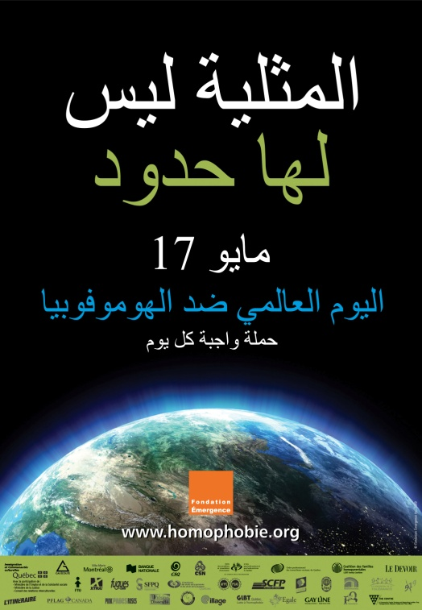
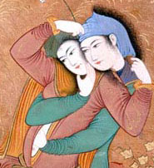
4. Qur’an & tradition
16

Slide 17
4. The Quran and the tradition of the Prophet of Islam
Quran & the worshipers of Ishtaar: the “sodomites”?
Again, the verses about the people of Lot in the Quran actually deal with violent practices dedicated to a pagan goddess (nothing to do with "homosexuality," or love between two people of the same sex and consenting).
Herodotus’ - an ancient historian (484-420 BC) - description of the Mesopotamian ritual rapes is very similar to the one made by the Quran:
"... Once in his life the tradition is to sit in the temple of love [dedicated to the goddess Ishtar/Aphrodite] and have ... sex with a stranger ... men go and make their choice. Whatever the amount of money, the woman never refuses, because it would be a sin, money being sacred by the present tradition”.
17

Slide 18
4. The Quran and the tradition of the Prophet of Islam
Systematic analysis: more than 70 verses in 9 chapters
(7.80-84, 11.69-83,15.51-77, 21.71-75, 22.42-43, 25.40, 26.159-175, 27.54-58, 29.28-35, 37.133-138, 50.12-13, 54.32-40 37, 66.10...)
Some verses are very clear (7.80):
It can not be homosexuality (which has always existed), but criminal behavior ("piracy", "rape" with young men but also young women, etc.).
It never speaks of "lesbian" women, yet Lot's wife died too (non-coherent, non-systematic / systemic analysis).
وَلُوطًا إِذْ قَالَ لِقَوْمِهِ أَتَأْتُونَ الْفَاحِشَةَ مَا سَبَقَكُم بِهَا مِنْ أَحَدٍ مِّن الْعَالَمِينَ
سورة الاعراف
«And [We had sent] Lot when he said to his people, "Do you commit such immorality as no one has preceded you with from among the worlds?»
18

Slide 19
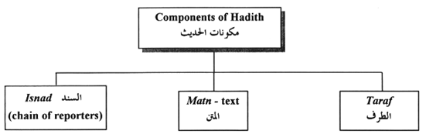
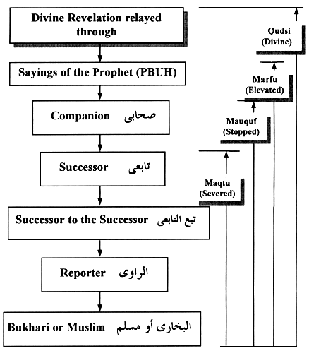
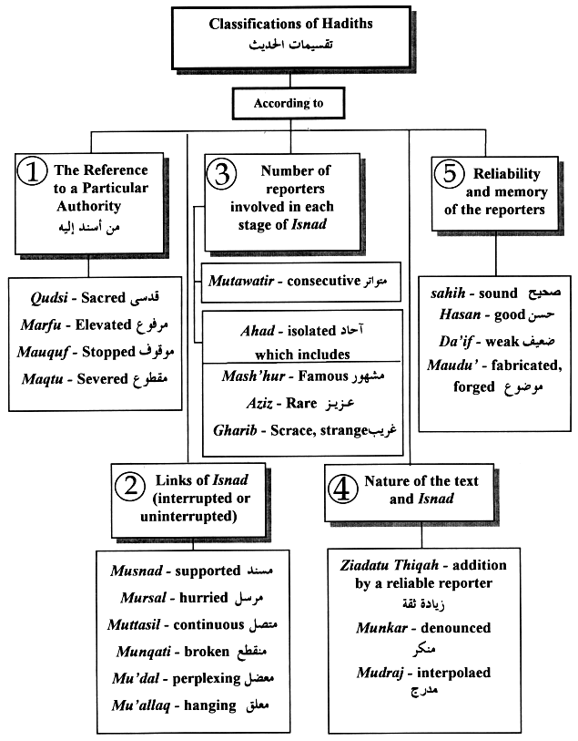
Other inconsistencies: “liars” & “thiefs”hadith classification
19

Slide 20
4. The Quran and the tradition of the Prophet of Islam
Other inconsistencies: Prophet ‘s ASWS inclusive traditions
Companion Abu Hurraïra reported a mukhanathan who had dyed his hands and feet with henna: the hallmarks of women's coquetry, like makeup nowadays. He was brought before the Prophet who asked:
"What's wrong with this man? It has been said, "Apostle of Allah! It affects the Women's Assembly! So he ordered him to be taken to a city near Medina. People said, "Apostle of Allah! Why not kill him? To which he replied, "I forbade anyone to kill people who pray" (Sunan Abu Dawud, Book 41, Number 4910).
20

Slide 21
4. The Quran and the tradition of the Prophet of Islam
Other inconsistencies: Prophet ‘s ASWS inclusive traditions
1 / The Prophet Muhammad (PBSL) proactively defended these transgender Muslims against what would be called today "homophobia", "transphobia“.
2 / The Prophet Muhammad (PBSL) would have welcomed at home the "mukhanathun", who served his children, his wives who did not veil in front of them.
3 / Khalif Omar said of Abu Hurairah (himself a former mukhanathan who internalized the homophobia of his time): "The most liar of the Mohaddithin [companions of the Prophet who report the hadiths they say they heard] is Abu Hurairah” (Tabari, Tafsir, op cit, volume XXI, p.157).
Aisha, the favorite woman of the Prophet, also rejected one of his hadiths: "Abu Hurairah, next time, when you begin to repeat the words of the Prophet of God, watch what you say" (Shaykh al-Islam al- Hafiz ibn Hajar al-Asqalani in al-Isaba fi Tamyiz al-Sahaba, volume VII, p.118).
21

Slide 22
4. The Quran and the tradition of the Prophet of Islam
«Sodomy»: at first, zoophilia condemnation and more
1 - However, it seems that the khalifes, after the Prophet, condemned "sodomites", who were not transgender or homosexual, but pagans who perpetuated the traditions of their patriarchal ancestors, mixing violent sexuality, imposed and idolatrous spirituality:
The first of those condemned for "sodomy" after the death of the Prophet was alleged to have been during the reign of the first of the Abu Bakr caliphs. He was called Fuja'a: one of the members of a tribe then in armed conflict against the centralized power in Medina, now weakened by the disappearance of the Prophet of God, as well as by the infighting that never really ceased between muslims.
This Fuja'a, the first of the "sodomites" of Islam, was a renegade, a political dissident with military practices particularly humiliating for his enemies. He was arrested by one of the Khalifat's famous generals,, known for his severity and his readiness to massacre whole populations, if the honor of thKhalid Ibn al-Walide Muslims was to be respected, and sometimes even in total contradiction with the recommendations of his own Prophet.
He was nicknamed "the sword of Islam", although the Prophet condemned some of these too violent initiatives. For example, during a military campaign against the tribe of Al-Jadhima, near Medina, he was quick to execute all the prisoners because he doubted their sincere conversion. Upon hearing this, the Prophet reportedly said, "O Allah, I am innocent of what Khalid Ibn al-Walid did “, repeating this twice (Bukhari, op. cit. ; Book 94, chapter 35, hadith 7276).
22

Slide 23
4. The Quran and the tradition of the Prophet of Islam
«Sodomy»: at first, zoophilia condemnation and more
2 - Yet this "sword of Islam", as some historians call K. Al-Walid, hesitates about how to execute this "sodomite". The latter is described in a missive addressed to Caliph Abu Bakr as "indulging in the practices of the people of Lot". But what do we know about this first "sodomite" condemned to death by the first khalifes of Islam, and especially the context of this condemnation hitherto unpublished?
Although this story is one of the most accurate about "sodomy", putting at our disposal several very valuable historical details, confirming that this would be an authentic tradition, there are still several points shadows about this Fuja'a.
Some traditions, or some versions of these traditions, create confusion between different "crimes": sexual relationship or another man is raped by Fuja'a on the battlefield, zoophile sex with an animal, consensual sexual relationship with a man sexually active.
The strength of details in the body of oral tradition tends to prove, in Islamic jurisprudence, that it was heard (or forged) by a relative of the Prophet; but it also means that this "tradition" was probably a simple opinion of one of the Prophet's contemporaries, close or not, since at that time the fiqh, the Islamic jurisprudence, was not so codified and strictly segmented than today: the difference between a companion's opinion and a teaching of the Prophet remains, in this, difficult to establish with certainty for this kind of traditions.
23

Slide 24
4. The Quran and the tradition of the Prophet of Islam
«Sodomy»: at first, zoophilia condemnation and more
3 – In another variant, closer to the Qur'anic ethic, many crimes are proscribed, among others the "crime of the people of Lot". This tradition has been incorporated into the collection of Hadiths by the famous Abu Dawud (817-888):
"God curses whoever sacrifices an animal to another deity than Allah, and God curses him who distorts the limits of creation, and God curses him who cuts the way to a blind man, and God curses him who insults his parents, and God he curses him who imposes himself on those who are not his slaves, and God curses him who indulges in the crime of the people of Lot“.
Or this hadith, attributed to a companion by the name of Jabir: "I have heard the Prophet say, 'What I fear most for my community is the crime of the people of Lot'" (A tradition reported by ' Ikrima, after Ibn 'Abbass, Ibn Hanbal: "Musnad", vol 1, page 309. See also Kugle, op cit, p 291, reference 90).
This is how the "sodomites" are described in the Qur'an as criminals, highwaymen, bandits who rape strangers, whether men or women, and not just as men having a preference, more or less exclusive, for other men. Yet this tradition also does not seem authentic, although more consistent than others in our systemic analysis in this area.
The great scholar of these hadiths who recollects this tradition specifies, himself, that it is very unlikely that the Prophet ever uttered such words. One of the reporters of this hadith, Ibn 'Aqil, is described as "of little confidence" (da'if al-hadith - ibn Hanbal, op cit, vol 3 page 382. See also Al-Tirmidhi: "Sunan", book 13, chapter 24, hadith 1529. See also Ibn Maja: "Sunan", book 21, chapter 12, hadith 2660).
24

Slide 25
4. The Quran and the tradition of the Prophet of Islam
«Sodomy»: at first, zoophilia condemnation and more
If I summarize all the ins and outs of such an episode, in relation to the status of "sodomites" in the first century of Islam, this is what it gives:
° No one was condemned during the lifetime of the Prophet for such a crime, not to mention the Islamic ethics of respect for the diversity of genres, quoted in the Qur'an and incarnated by the Prophet throughout his life;
° The proper caliphs of Islam had to meet in order to advise one of the bravest and rash companions of the Prophet concerning the conduct to be followed on such an occasion;
° He was not acting out of a specific category of mukhannathun (gay or transgender), but rather of a criminal, a highwayman, who was burned at the stake in public place, in order to make an example for those who might have had the idea of ​​rebelling against the young centralized political power in Medina;
° His nickname Fuja'a - his real name Ilyas Ibn 'Abd Yalil - tells us that such a character was a fierce fighter, who would have considered that to humiliate his enemies (by the rape on the battlefield) was a added value, also financial, for the honor and the politico-religious prestige of his tribe;
° And finally, no trace of a sexual partner of Fuja'a, even though many traditions, apocryphal, would condemn the assets and liabilities involved in sex between men.
25

Slide 26

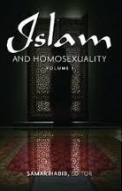
E. Examples of inclusive Islamic publications
These subjects are brainstormed mainly in the commission Reflection Islam of HM2F, and during our CALEM plenary conferences and seminars.
Khaled Al-Rouayheb
"Before homosexuality in the Arab- Islamic world"
The author gives great bibliographical references about sexual orientation and gender diversity within Islam, as a civilization, before the modern era.
Reflection Islam – 14th October 2011 - http://www.homosexuels-musulmans.org/compte_rendu_RI.html
Samar Habib
"Islam and homosexuality"
The author put in exergue self-determination of queer from the arab-Muslim (mainly those who lives in the West) and their emancipation toward neocolonialism.
26

Slide 27
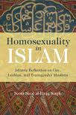
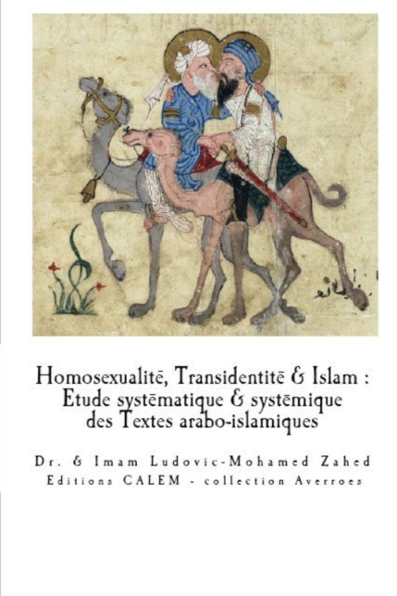
E. Examples of inclusive Islamic publications
Scott Siraj Kugle
"Homosexuality in Islam"
The author analyses in a brilliant, but nonetheless personal way, the evolution of same-sex relationships’ representation among the Islamic civilization, from an essentially theological perspective.
CALEM éditions - WWW.CALEM.EU (2017)
« Homosexualité, transidentité & Islam »
CALEM editions (a structure that has existed since the beginning of the 2000s) aim at proposing an in-depth catalog of references dealing with theological, sociological, sexual and cultural topics, in particular in relationship with Islamic religiosities, so-called "Arab" cultures", feminisms, homosexualities and trans-identities.
(Free PDF online)
27

Slide 28

E. Examples of inclusive Islamic publications
All our publications on the topic (in Tunisia, Algeria, post Arab-Spring contexts), are available in PDF for our trainees for free: info@calem.eu
28

Slide 29
F. Extended bibliography
Al-‘Uzziy (1981). « Difaa’ ‘An Abi Huraïra ». Maqtabat Al-Nahda, Baghdad.
Ali, K. (2006). « Sexual ethics and Islam ». Oneworld, London.
Al-Jazeera, émission Sharia and Life (Juin 2006), épipsode intitulé : « Fitrah Allah fi khalqihi ». Voire aussi la retranscription intégrale de cet épisode traduite par Kugle, infra ; p. 152-3.
Al-Maqrizi (1994). « Mukhtasar al-kamil fi al-duafa wa ilal al hadith li Ibn Adi ». Muktabat al sunnah, Le Caire.
Al-Qurtubi (1411-1995). « Tafsir al-jami' fi ahkam al-Qur'an », vol. 7. Beyrouth.
Amreen, J. (2001). “The Story of Lut and the Qur’an’s Perception of the Morality of Same-Sex Sexuality.” Journal of Homosexuality 41, no. 1.
Dening, S. (1996). « The Mythology of Sex », chapitre 3. Macmillan General Reference, New York.
Gebara, I. (2000). « Théologie de la libération au féminin et théologie féministe », in « Théologies de la libération ». L’Harmattan, Paris.
Ibn 'Ata Allah Al-Iskandar, traduction de Kugle, S. (2005). « The book of illumination » [ Kitab Al-Tanwir].
Ibn Hazm (1995). «The ring of the dove ». Luzac oriental.
Ibn S'ad Al-Baghdadi (~844-2013). « Kitab al-tabaqat al-kabir », vol. 2. Islamic book service, Inde.
Izutsu, T. (2002). “Ethico-Religious Concepts in the Qur'an”. McGill-Queen's University Press, Montreal.
Juynboll, G., H., A. (1983). « Muslim traditions: achronical ». Cambridge University Press.
Kugle, S. (2010). « Homosexuality in Islam ». Oneworld, Oxford.
Marongiu-Perria, O. & Privot, M. (2012). « L’homosexualité : un défi théologique ». Oumma.com. Disponible en ligne - http://oumma.com/15178/lhomosexualite-un-defi-theologique.
Massad, J. (2007). « Desiring Arabs » ; University of Chicago Press.
Mernissi, F. (1987). « Le Harem politique : le Prophète et les femmes ». Albin Michel, Paris.
Mezziane, M. (2005). « Le sodomite et l’efféminé dans l’Islam du IXe-XIe siècle. Statut juridique et représentations sociales ». Mémoire de DEA - EHESS, Paris. Disponible en ligne - http://www.mohammedmezziane.com/Mezziane-sodomite-effemine.pdf
Muhammad Al-Jazari, (1932). « Ghayat al-nihaya fi tabaqat al-qurra' », vol. 1. Maktabat al-hangi, Le Caire.
Noureddine Ibn Moukhtar Al Khadimi (1998). “Al Ijtihad Al Maqasidy”, n°65. Kitab Al Oumma, Qatar.
Rouayheb, K. (2010). « L’amour des garçons en pays arabo-islamique : XVIe-XVIIIe siècle ». Epel, Paris.
Schacht, J. (2012). « Ikrima, mawla Ibn Abbass », in Encyclopedia of Islam (second edition).
Schmitt, A. (2001-2002). « Liwat im fiqh : Männliche homosexualität ? ». Journal of Arabic and Islamic studies 4 : 61.
Shaban, M., A. (1976°. « Islamic history: a new interpretation », vol. 1. Cambridge University Press.
Tafsir Ibn ‘Abbass (L’exégèse d’Ibn ‘Abbass). Disponible en ligne - faculty.ksu.edu.sa/yf/DocLib71/تفسير%20ابن%20عباس.pdf
Youssef, O. (2008). « Hayrat muslimah » (La stupéfaction d’une musulmane). Dar sahar lil nashr, Tunis. Voire
Zafeerudin (1998). « Islam on homo-sexuality ». Darul Ishaat, Pakistan.
Zahed, l. (2017). « LGBT musulman-es : du Placard aux Lumières, face aux obscurantismes et aux homonationalismes ». CALEM, Marseille.
29

Slide 30
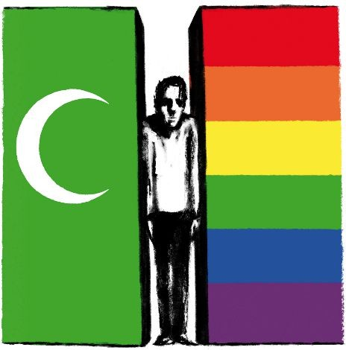
5. Fascism: product of social context, cultural facade and / or religiosity?
30

Slide 31
5. Fascism: social, cultural et religious factors?
What is the Islamic «shari’a»
We already talked about those different concepts:
Shari’a = path towards “Illumination” (not dogmatic “jail”)
Fiqh = Muslim’s understanding of the Divine message (not a “law”)
Culture = the product of inter-individual interactions (evolving according to history, economics, education, politics, etc.).
NB: The only law is the Respublica (“belonging / decided to / by all of us) democratic one nowadays in secular societies, and God wanted it to be so); see Plato
31

Slide 32
5. Fascism: social, cultural et religious factors?
What is the Islamic «shari’a»
We already talked about those different concepts:
Shari’a = path towards “Illumination” (not dogmatic “jail”)
Fiqh = Muslim’s understanding of the Divine message (not a “law”)
Culture = the product of inter-individual interactions (evolving according to history, economics, education, politics, etc.).
NB: The only law is the Respublica (“belonging / decided to / by all of us) democratic one nowadays in secular societies, and God wanted it to be so); see Plato -> Human cultures either evolve on that “natural” path, decided by the Divine’s wisdom for His/Her/Its creation, or disappear (Quran: 49.13).
32

Slide 33
5. Fascism: social, cultural et religious factors?
DAESCH, islam (spirituality) or Islam (civilisation)?
Great theoretical debate at the moment (Todd, Roy, Kepel, etc.). Here the "Islamists" use the most violent apocryphal hadiths to justify a fascisation of identities on both sides of the Mediterranean (Emmanuel Todd: “Qui est Charlie", 2015; or Olivier Roy: “La sainte ignorance”, 2012).
Deny the most truthful inclusive hadiths, most consistent with the rest of the Islamic spiritual traditions
Their strategies are in every way in line with those of all fascist groups, applying their policy of "scapegoating" minorities in the entire public space (see Zahed, L. (2017). “LGBT Muslims...").
Like any civilization, the so-called "Arab-Islamic" undergoes waves of pan-Arabism, the temptation of fascism and "biopower (Mr. Foucault). There is no "oriental despotism" (nineteenth century) and even less "islamo-fascism" (twentieth century).
33

Slide 34
5. Fascism: social, cultural et religious factors?
DAESCH, islam (spirituality) or Islam (civilisation)?
Khaled Rouayheb (2009), or Walter G. Andrews and Mehmet Kalpakli, highlight in a remarkable way the subsequent influence of modern medicine of a puritanical Europe on an Ottoman empire that some describe, at the turn of the twentieth century, as declining, or at least seeking medicalizing scientific expertise elsewhere than within it.
The nineteenth and the beginning of the twentieth century seem to have been those, from this point of view, of the emergence of the social category of "abnormals", as M. Foucault very precisely describes it in his eponymous work (1976).
A description of the social mechanisms linked to the power still relevant today, with the difference that, today, the individual is fundamentally described as an agent, and no longer as essentially vulnerable (Becerra & Peltier 2009: 117-128) although undergoing more than ever the oppression of a corporality subject to an omnipresent "biopower" (Foucault op.cit.); biopower, which now acts under the guise of democracy and to ensure individual liberties for all, can in fact sometimes increase the pressure of fascist identity control on some.
34

Slide 35
5. Fascism: social, cultural et religious factors?
DAESCH, islam (spirituality) or Islam (civilisation)?
Consequences of this modernity? Some examples:
1 - in Cairo in 1925, the collection of the One thousand and One Nights famous (ante-Islamic literature multicultural heritage in Arabic) is published, for the first time in over a thousand years, expurgated from all the references related to corporality, to the sexuality of women or to male homoeroticism .
2 - such puritanism did not seem to exist in Arab-Muslim public spheres before (Tifashi 1981). For example, inspired by a tradition dating back to medieval times, Damascene judge Muhammad Akmal Al-Din reported the following story:
  "A man loved a hairless binder called 'Ali, but this one turned out to be hermaphrodite. The doctors decided and declared it more of a feminine gender, which allowed the local judge to consider that the bookbinder was a woman; 'Ali immediately becoming' Aliya, and could therefore become the husband (or rather the wife) of his suitor “ (Rouayheb, op cit.).
35

Slide 36
5. Fascism: social, cultural et religious factors?
DAESCH, islam (spirituality) or Islam (civilisation)?
Before the modern era, therefore, in the eighteenth century, the relationship to gender, corporality and homoeroticism did not pose as many problems. Then:
"In less than a century, the antipathetic attitude towards the pederast love [up to a recent time] attributed to the French was adopted by the advanced classes of Arab societies” (Idem).
The beginning of the twentieth century is thus characterized from this point of view by a questioning of identities, in general, described as fascist (an identity fasce, beam / also from phallus), even totalitarian (in the totality of the public space), in colonized Arab-Muslim societies, decolonized for some, traumatized, with the weakened social dynamics, in the grip of doubts and phobias of all kinds, in active search - at the limit of a perfect correspondence with the psychopathological picture of hysteria - of scapegoats, such as emancipated women or individuals belonging to a sexual minority.
A classic scapegoat research process, a priori, given the data available in sociology of intergroup dynamics, for example, with regard to the condition of minorities within social groups, considering to be, rightly or wrongly, endangered.
36

Slide 37
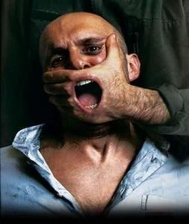
6 A - Infrahumanization, THEORETICALY.
Not respecting human rights, why!?
Notes:
Definitions

Slide 38

SUMMARY
A – Infrahumanization, theoretically
B – Infrahumanizing sexual minorities
Notes:
Summary

Slide 39

What is Infrahumanization ?
SOCIAL PHENOMENON
That social phenomenon is tacitly held by an unconscious belief that one’s in-group is more human than an
out-group
Notes:
Définition :
Infrahumanisation refers to the tacitly held belief that one's ingroup is more human than an outgroup. The term was coined by Jacques-Philippe Leyens and colleagues in early 2000 to distinguish what they argue to be an everyday phenomenon from denial of humanness associated with extreme intergroup violence such as genocide. According to Leyens and colleagues, infrahumanisation arises when people view their ingroup and outgroup as 'essentially' [see [essentialism]] different and accordingly reserve the 'human essence' for the ingroup and deny it to the outgroup.
The belief that the outgroup is less human than the ingroup is seldom consciously endorsed by individuals [(c.f., dehumanisation)] and instead is reflected in the way people tacitly think about the outgroup. Researchers have typically investigated infrahumanisation by looking at the types of emotions people believe ingroup and outgroup members possess. Some emotions are considered unique to humans [(e.g., love, regret, nostalgia)] whereas others are viewed as common to both humans and animals [(e.g., joy, anger, sadness)]. In a series of studies Leyen's and colleagues have widely replicated the finding that people attribute unqiuely human emotions to the ingroup, but not the outgroup. According to infrahumanisation theory, the denial of uniquely human emotions to the outgroup is reflective of the belief that they are less human than the ingroup.
Recent research has investigated how infrahumanisation influences behaviour. In a series of studies Jeroen Vaes and his colleagues investigated people's reactions to outgroup members who attempt to 'humanise' themselves through the use of uniquely human emotions. They found that ingroup members reacted negatively to outgroup members' attempts to humanise, offering less help and withdrawing faster than when the same uniquely human emotion was expressed by an ingroup member or when the outgroup member expressed a non-uniquely human emotion. In an American context, Cuddy and colleagues have investigated the influence of infrahumanisation on intergroup helping behaviour. Examining helping in the aftermath of Hurricane Katrina, Cuddy et al. found that people believed outgroup members experienced less negative uniquely human emotions than ingroup members. Importantly, the degree to which they infrahumanised the outgroup member was related to their report likelihood to offer assistance. Specifically, the more participants infrahumanised the outgroup member the less likely they were to help.
SITUATION REELLE :
Continuer par rappeler situation de stigma and discrimination around throughout history, and especially today in many countries (selon rapport amnesty international).
Une discriminisation et des préjuges qui subsistent malgré le fait que les specialistes en sciences humaines ont compris il y a plusieures decennies, que la sexualite humaine est bien plus complexe que ce que les medecins du 18eme siecle ont pu pense (en inventant le mot « homosexualite » afin de classifier les minorites sexuelles dans des categories qui ne correspondent pas a la realite). Les scientifiques europeens se sont trompes et aujourd’ hui ils reconnaissent leur erreur. Pourtant ils ont exportes leurs conception erronnee et leur loie dans des colonnie, aujourd’hui devenus des pays libres, qui defendent pour certaines (par exemple en Ouganda) des loies discriminantes a l origine europeennes : une discrimination que ces pays musulmans défendent pourtant au nom de l’Islam, alors qu elles decoulent en realite d une theorie scientifique nee en Europe, depassee depuis plus d un siecle (une contradiction géopolitique effrayante) !
Puis dire que cette discrimination violente toujours, directe ou indirectement, que ce soit par la passe ou encore aujourd’hui, repose toujours, inéluctablement, sur des mécanismes psychologiques bien connus aujourd’hui en sciences cognitives (un genre de psychologie tournée vers l’étude des processus et des mécanismes mentaux), que les extrêmes utilisent pour nous utiliser a des fins politiques.

Slide 40
Endangered inner-group
ANIMAL INSTINCT
Infrahumanization is a basic, instinctive reaction by which endangered groups reinforce their group frontiers; scapegoats to catharsis inner-group’s fears !
Notes:
(…)

Slide 41
Unconscious or deliberate ?
UNCONTROLABLE
Produced by an individual or a group of individuals ; here is the “recipe” to ostracize someone without
feeling guilty about it…
It doesn’t mean they are not guilty; but analyzing infrahumanization that is the source of discrimination from a scientific point of view, allows us to addresses the issue of discrimination, without falling into the political pitfall of essentializating a culture or a belief, saying for instance: “Islam is homophobic”, full stop.
That pitfall would close the debate with all Muslims about homophobia; plus, it shall make us appear - we LGBT and human rights activists - for Islamophobic racists.
Notes:
(…)

Slide 42
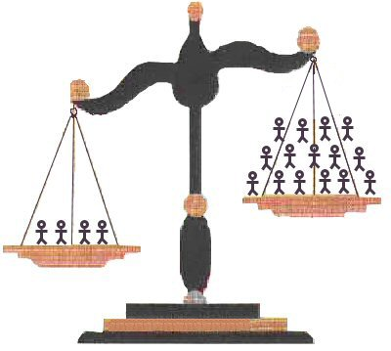
Seldom endorsed by INDIVIDUALS alone!
NO emotions, NO faith
Endorsed by a majority, against a minority
Being more numerous helps to thing you are right
Denial of Humanity (“they have no true human emotions” - “they are beasts” - “they have no human faith” - “it is not a sin to hurt them”...)
Robust scientific proofs
The more participants infrahumanize the out-group member the less likely they were to help.
Notes:
(…)

Slide 43
How far ?
MORTAL SOCIAL ILLUSION
“Denial of humanness associated with extreme intergroup violence such as genocide”
(Leyens & al.)
[1] Leyens & al. (2009). “From infra-humanization to discrimination: The mediation of symbolic threat needs egalitarian norms”. Journal of experimental social psychology; 45-2, p.336-344.
Notes:
(…)

Slide 44
6 B - Infrahumanization
PRACTICALLY: why sexual minorities!?
Notes:
It is good not think we have all the answers (we don’t have to and we do not have to feel guilty about not having all the questions. Do extremists have all the answers to justify their violence ? Certainly not.
Plus, personally I am no one, nothing and Allah alone is the Almighty.
So let’s think about some constructive questions :
We all know about the violent rapes condemnation in the Quran and some hadiths (People of Louth).
But we still could think of at least, 5 questions : so please try to read the questions and give an short answer, in on sentence maximum.
We shall peak up one of your proposal and think of it : there is no true or false answer, it is a free willing personal reflection that we shall try to enrich with one another…

Slide 45
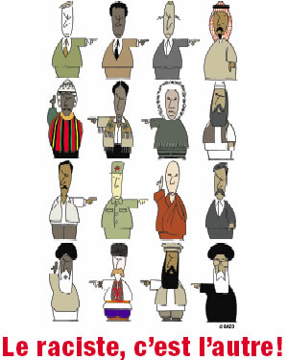
«I am not guilty!»
Why is it so important for them insist on homosexuality, as “one of the most sensitive issues facing Muslims living in the West, particularly in Europe” ?
(like Leyens & al. said that violence, sometimes could genocide an entire population : Nazis, apartheid, sexual minorities… scapegoat !)
45
Notes:
Why is it so important for them insist on homosexuality (a detailed not even concerning our faith Usul : the basic pillars of Islam), as “one of the most sensitive issues facing Muslims living in the West, particularly in Europe” ?
[4] Answer to T. Ramadan’s article entitled “Islam and homosexuality” : http://www.homosexuels-musulmans.org/infrahumanisation_deshumanisation_violente_et_justice_de_la_reforme_de_l-islam_de_france.html#Tariq_Ramadan
Probably because every endangered human group (and the arabo-islamic civilization is a huge human group, no matter its size) desperately need to endeavor a “purification”, they say, beginning with the out-group. And like Leyens & al. said that violence, sometimes could genocide an entire population (apartheid in South Africa, when the former elite was about to lose the political power and felt endangered ; Nazis exterminating Jews but also gypsies and homosexuals when they thought they were gone to lose the war). At that particular moment infrahumanization is what we call “scapegoat” !

Slide 46
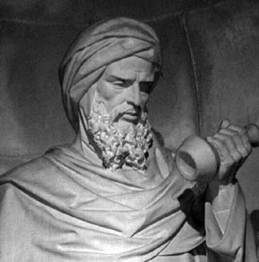
Our truth
We shall insist on “Rahma”, an entire surat dedicated to empathy
The executioner need infrahumanization to violate the victim’s human dignity
Infrahumanization makes the victim suffering, it certainly alienates the executioner
46
Notes:
But Infrahumanization also shows that God in his great kindness to create "empathy“ : an entire sourat called "Al-Rahman” ! And because of empathy, executioners need to infrahumanize their victims before they could think of eliminating them politically or sometimes even physically.
Our spirit (al-nafs) could not straight forward reject some other human’s dignity : it has first of all to consider him as inhuman ; but truly it is the executioner itself that has to alienate himself/herself before even to think about how to suppress other humans’ dignity !

Slide 47
Instaure a peacefull dialogue
Peaceful dialogue to educate, purify ourselves, others representation
Continue pointing at stigma, & discrimination, fight prejudices
18th century European doctors were wrong, direct - indirect violence
Neither Islam nor LGBT have anything to win from direct nor indirect violence of infrahumanization , dehumanization !
[2] http://www.kinseyinstitute.org/
[3] American Psychiatric Association - DSMIV: Diagnostic and Statistical Manual : http://www.psych.org/mainmenu/research/dsmiv/dsmivtr.aspx
[4] Amnesty international report : http://www.amnesty.org/en/library/asset/POL30/003/2008/en/d77ce647-4cd3-11dd-bca2-bb9d43f3e059/pol300032008eng.pdf
47
Notes:
Continue by pointing stigma and discrimination situation around THROUGHOUT history, and Especially in today Many countries (Amnesty International, according to the report).
Discrimination and prejudices persist despite the fact that human sexuality is much more complex than the doctors of the 18th century were thought (by inventing the word "homosexuality", to classify sexual minorities into categories that do not correspond to reality). The European scientists were wrong and today they recognized their mistake; we are enhancing scientific knowledge about human sexuality. Yet that limited and discriminating misconception of sexuality and gender has exported in colonies, now free countries, which defend some discriminating European laws (in Africa or Middle-East).
It is a historical schizophrenia to defend homophobic laws in the name of Islam, since these laws elaborated during the modern era are not based on Islamic ethics! Neither Islam nor LGBT activists have anything to win from violence of infrahumanization. If we want to adopt the appropriate measures to fight back homophobia, transphobia, we have to analyze first with great scrutiny the real, deep, robust roots of that violence against individuals belonging de facto to sexual minorities.

Slide 48

7. GIN – Global Interfaith Network
48

Slide 49
GIN-SSOGIE introduction / 1
In a time when the Lesbian, Gay, Bisexual, Transgender and Intersex (LGBTI) communities all over the world increasingly are organizing themselves, demanding the space to exist, to meet and to find protection under the law, the forces against these rights are being mobilized. This is happening on both national and international levels. These forces claim to justify their fight with religious rhetoric, cultural claims and customary laws; arguing that sexual and gender diversity are foreign and evil imports.
Dealing with these issues often brings controversy, condemnation, exclusion, internalized transphobia and homophobia, and can result in violence and hate crimes, often justified by religious and cultural beliefs. The irony is that it is often religious movements from outside, for example American Fundamentalists pushing national politicians and religious leaders in Uganda or Nigeria to make the already existing laws against LGBTI people even more severe, like death penalty or life imprisonment.
49

Slide 50
GIN-SSOGIE presentation / 2
In such situations there is a strong need for LGBTI people from these countries and of all faiths to come together to share experiences of dialogue with religious leaders, both failures and successes, to build international solidarity and to strengthen our identities both as LGBTI people and believers.
Strategic dialogues and consultations are critical among LGBTI individuals and groups in order to determine a way forward for advocacy of equal legal treatment, social opportunity, and safety that directly addresses the question of religious instigated persecution.
The special area of expertise of the Global Interfaith Network is the ability to underpin the human rights approach to LGBTI issues with theological convictions and address religion-based challenges to our human rights with theological arguments and the capacity for (inter)religious dialogue.
50

Slide 51
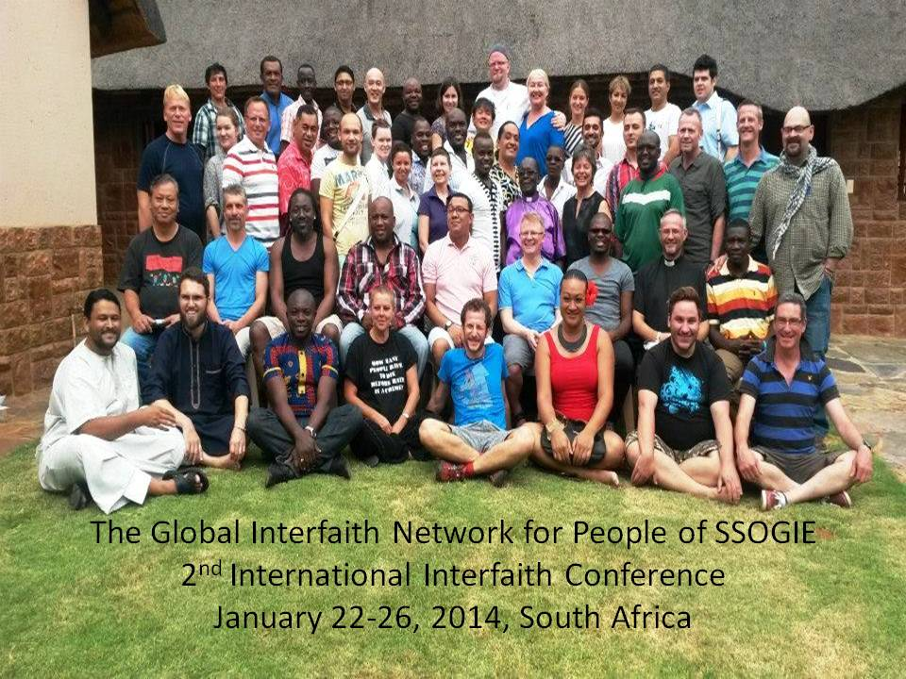
GIN-SSOGIE - Johannesburg 2014
51

Slide 52
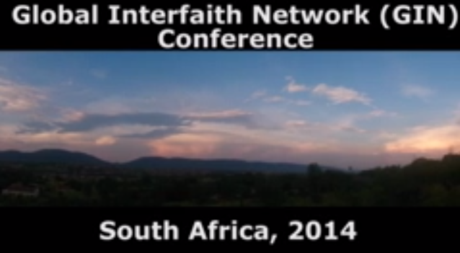
GIN-SSOGIE documentary
Thanks to Jabu (Iranti)
http://youtu.be/kkyvNo411Lo
WWW.CALEM.EU - INFO@CALEM.EU
52

Slide 53
CONTACTS
EDITIONS : france.calem@gmail.com
--
INSTITUT (professional trainings) : info@calem.eu
--
CABINET (psycho-spiritual support) : calem.conference.2010@gmail.com
Counselling with Dr. L. Zahed also possible through Skype: l.zahed
--
Telephone: 0667087066 / 0667466406
WWW.CALEM.EU - INFO@CALEM.EU
53

